Slide 1
City of Portsmouth
Projects & Progress

Slide 2
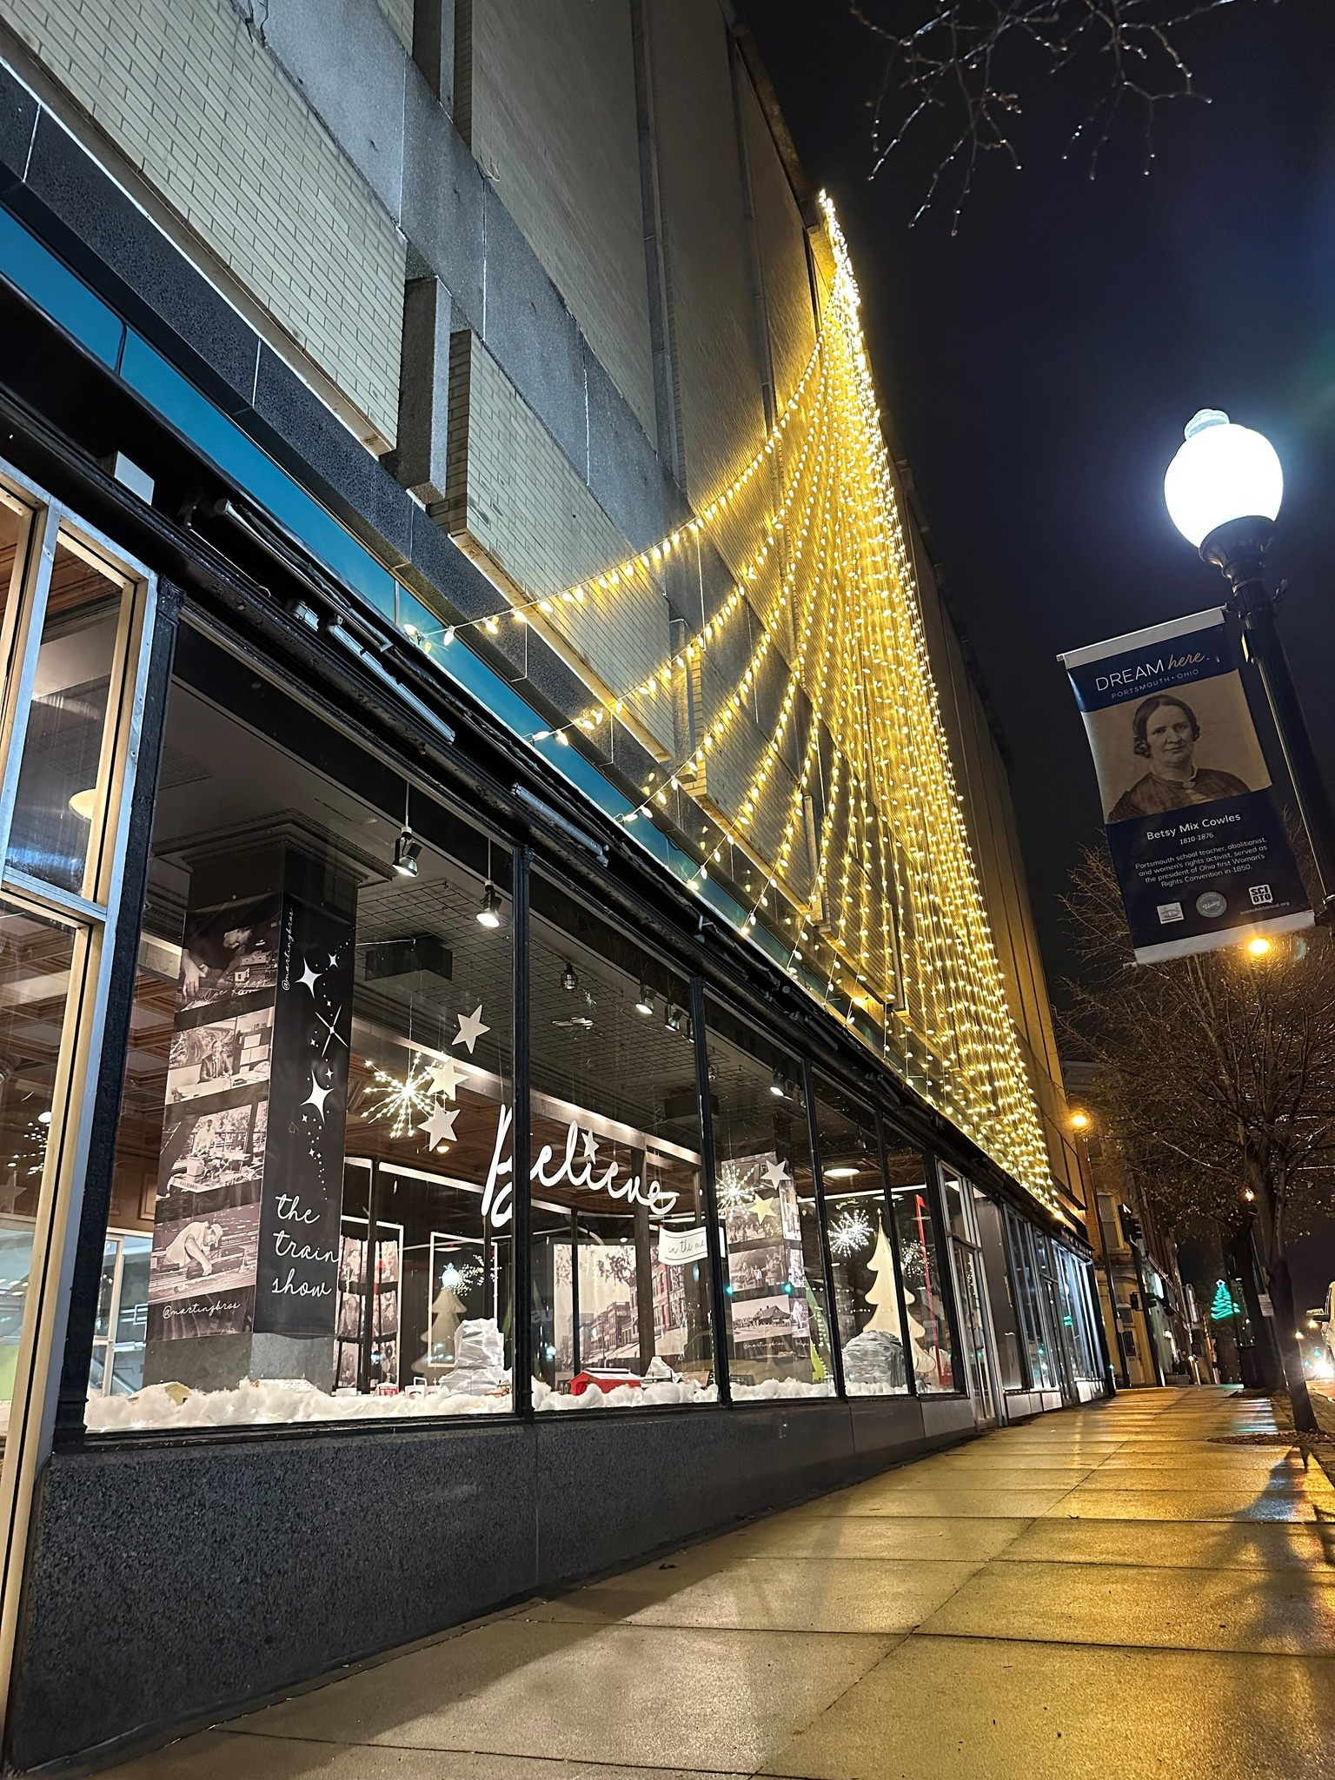
Marting’s Building
In a collaborative effort with the Scioto County Commissioners, Southern Ohio Port Authority, the City of Portsmouth and a private developer; the former Marting’s Building has been transferred and is in the process of being rehabilitated. The abandoned department store has been vacant for decades, but now a joint effort has assisted in revitalizing Downtown Portsmouth.

Slide 3
Scioto County Active Transportation Plan
The City of Portsmouth collaborated with ODOT and OVRDC to develop an Active Transportation Plan in 2020 which help guide the City for future projects and our efforts in obtaining grant funding.
This Active Transportation Plan grew out of the need to provide more opportunities for physical activity and safer, more equitable transportation options.
https://portsmouthohio.org/wp-content/uploads/2021/10/03-03-2020-Scioto-Active-Transportation-Plan_Small.pdf

Slide 4
City of Portsmouth Development Plans
In 2020 the City of Portsmouth developed a Downtown Master Plan through public engagement with citizens, stakeholders and local leaders to set forth a vision of the future of the city.
Common interests included Downtown & Riverfront Development
https://portsmouthohio.org/wp-content/uploads/2021/10/2020-Master-Plan-Final-Elevate-Portsmouth-MP-Book-LR-002.pdf

Slide 5
Master Plan Progress
Market Street Pavilion
100% Funded by CDBG Grant, Local Government, Scioto Foundation Grant
Completion Date of June 2023

Slide 6
Downtown Wayfinding Recommended in the Master Plan 100% Funded by Local Government & the Scioto Foundation Installation May 2023

Slide 7
Downtown Development
The City of Portsmouth recently purchased the 5/3rd Building on Chillicothe Street for the Municipal Building. This arrangement will meet necessary spacing requirements, future needs of City Government and revitalize Chillicothe Street.
This transaction will also offer new development potential at the old location on Front/2nd Street.
The City secured $1.4M in grant funding and is committing $1.6M in local funds.
This development was made possible through collaboration with the Scioto County Commissioners.

Slide 8
Riverfront Development- Port of Portsmouth $2.4M in funding secured ( needs additional funding)

Slide 9
Alexandria Point Paddling Facility
Currently in the permitting phase with Army Corp of Engineers & Ohio EPA
Hopeful to construct in 2023
75% funded through ODNR
Project will consist of a primitive paddling ramp along the Scioto/Ohio River

Slide 10
Spartan Stadium Sports Complex & Rec Center As mentioned in the Master Plan, the development of a Sports Complex/Rec Center would serve as a central park, host games and tournaments and provide a recreational & health center for underserved children. This project would only be possible with grant funding.

Slide 11
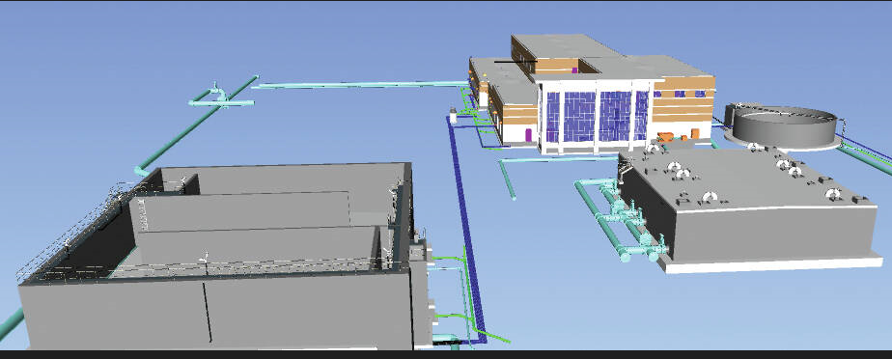
The City of Portsmouth will be breaking ground for the new Water Treatment Plant in January 2023 for an estimated cost of $67M $4.5M Secured with grants, the additional will be funded through low interest loans.

Slide 12
Portsmouth supplies water to South Shore Water Supplyhore, Ky
The City of Portsmouth is currently providing South Shore Kentucky with approximately 280,000 gallons of drinking water a day. Although, a temporary fix via a waterline that runs along the Grant Bridge, we are working with the City of South Shore for a permanent solution.

Slide 13
Additional Water & Wastewater Projects
Franklin Furnace Booster Station-100% grant funded, $1.2M cost estimate. This project will increase water pressure to Franklin Furnace Industrial Park and maintain pressure as additional businesses develop.
Munn’s Run-Partially grant funded. $2M cost estimate. This project will alleviate sanitary sewer overflows in the area known as Munn’s Run Sewer Shed.
Orchard Drive Drainage System Upgrade- 60% grant funded and $227,000 estimated cost. This is a culvert replacement and upgrade project to alleviate flooding in the residential area between Orchard Drive and Sheridan Road.

Slide 14
Portsmouth Elementary Safe Routes To School Project
Construction will begin this year
$440,000 cost estimate, 90% funded through ODOT
Provide traffic calming measures
Safer crosswalks & crosswalk locations
School zone flashing beacons
High visibility signage
Curb extensions

Slide 15
Coles Boulevard Roadway Improvement Project
Improve roadway standards & pavement conditions
Enhance safety and traffic operations
Improve non-motorized facilities
Upgrade storm drainage system
Reduce crash frequency
$5.5M Cost Estimate
Partially funded through ODOT $2M

Slide 16
Additional Plans & Studies
2021 Portsmouth Housing Study
https://portsmouthohio.org/slug/redeveloping-in-the-comeback-city-a-comprehensive-housing-market-analysis/
2022 Zoning Code update
https://portsmouthohio.org/draft-zoning-code-update-for-public-review/

